Slide 1

Iteration 5 Queen bees bienenkonigin
Mikhaela Mueller, Meredith Hogue, Minu Perera, Narbada Acharya, Jack Hickey

Slide 2
Agenda
Class Diagram
Window Navigation Diagram
Layout Diagram
Prototype
Summary

Slide 3
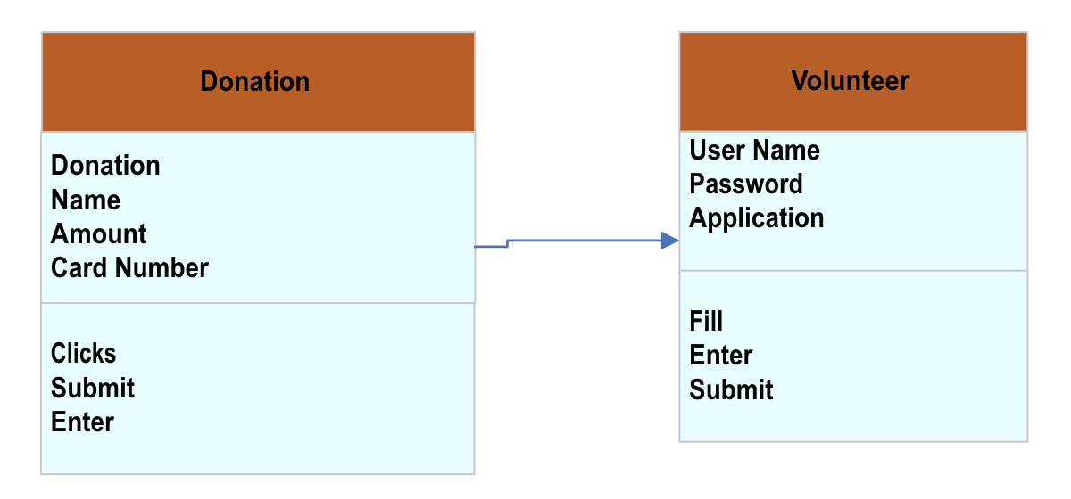
Class diagram
Diagram that visualizes different attributes and methods within the system and the relationships between them

Slide 4
Window Navigation Diagram
This is a tool that helps visualize the navigation of the website for developers by mapping the navigation between interfaces

Slide 5
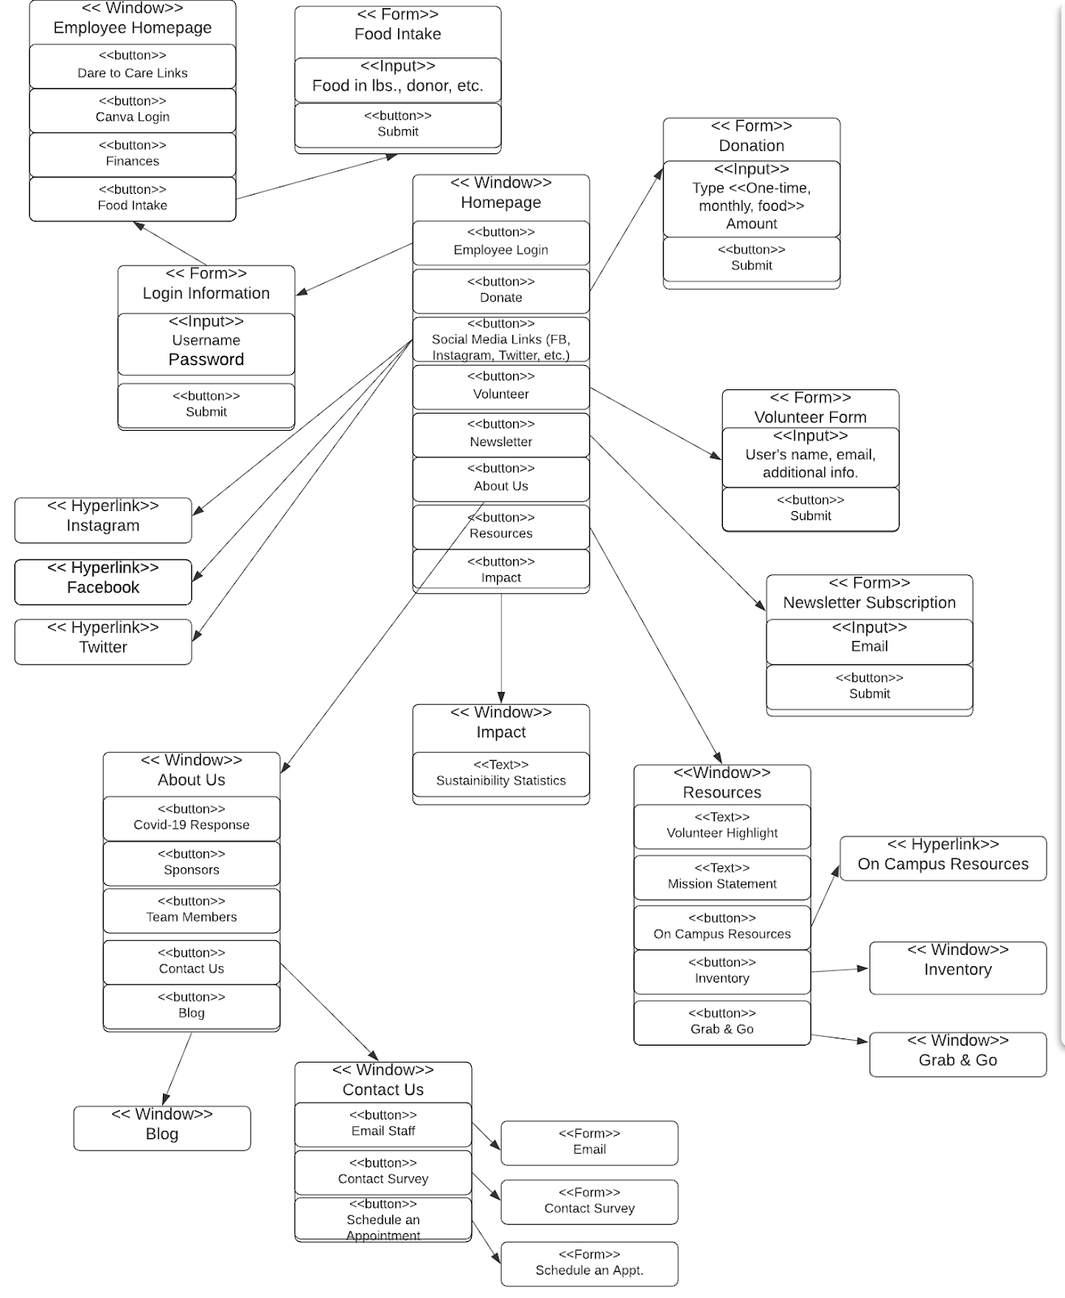

Slide 6
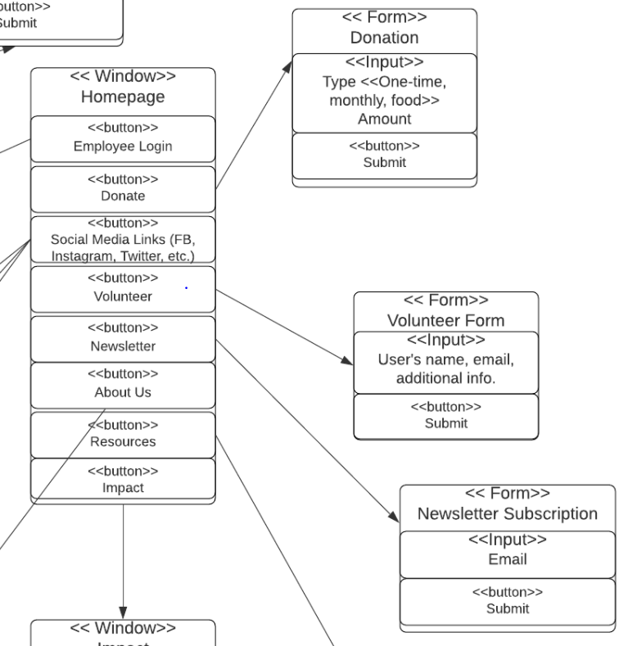

Slide 7
Layout Diagram
Similar to the navigation diagram, but it is in the form of a storyboard that more closely resembles what the actual interfaces will look like

Slide 8
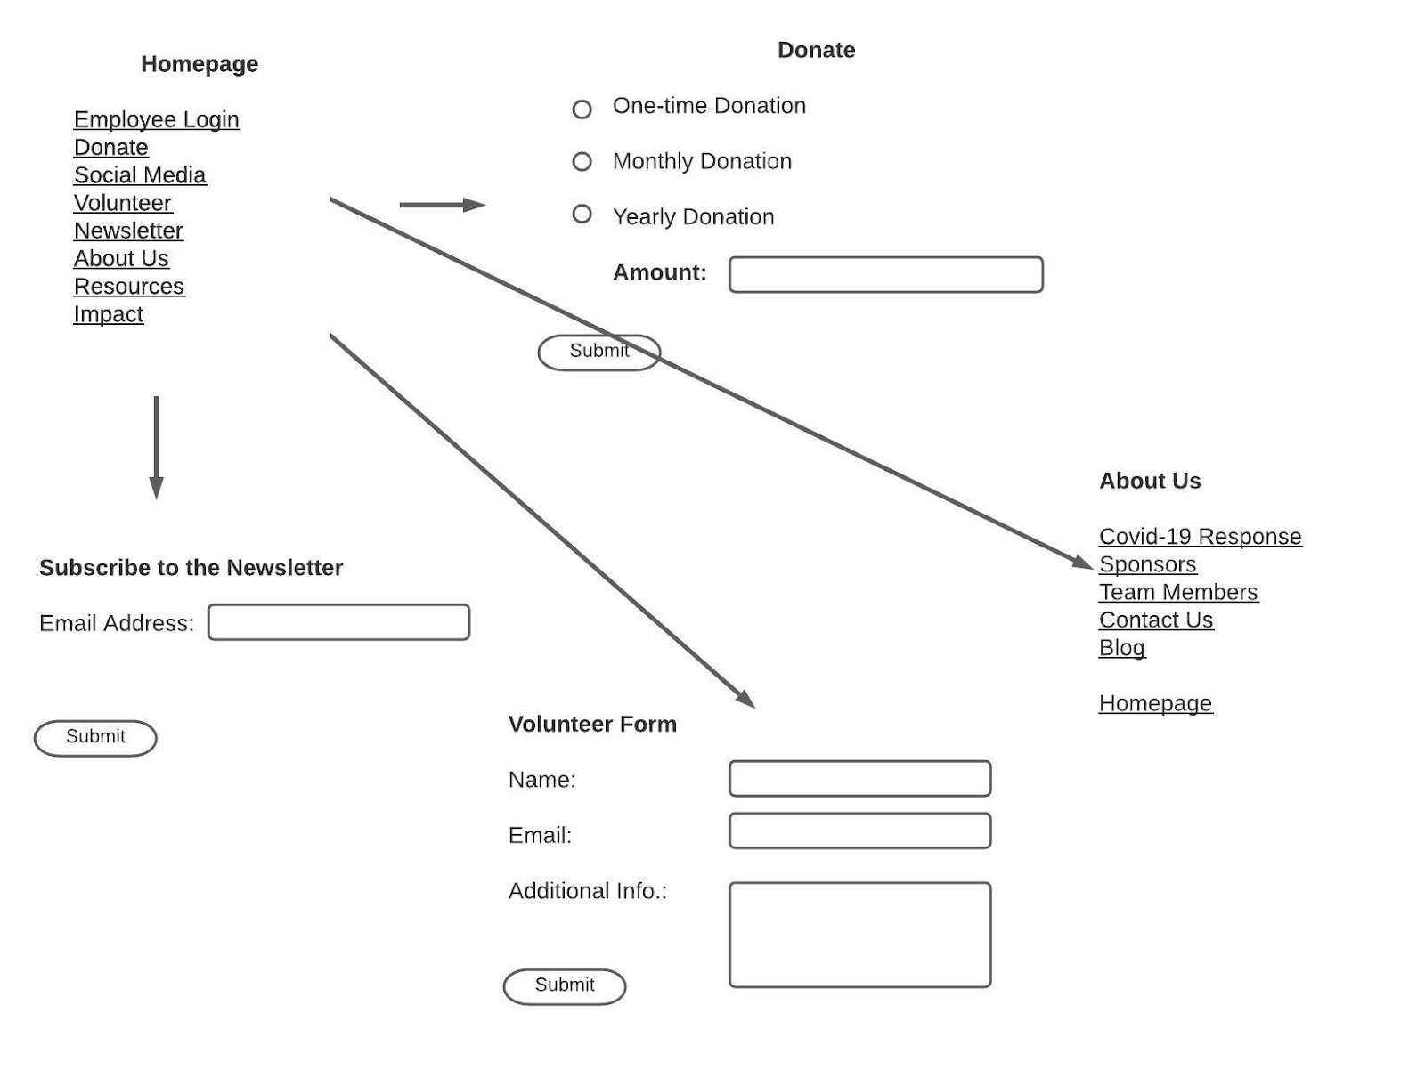

Slide 9
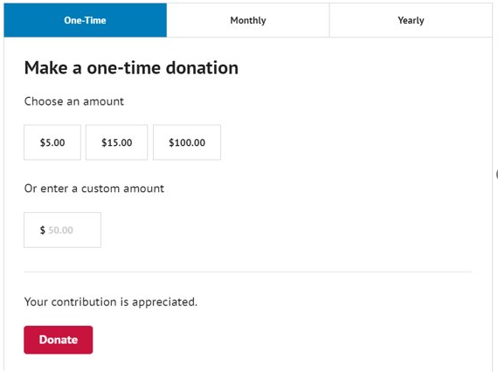
Prototypes donation

Slide 10
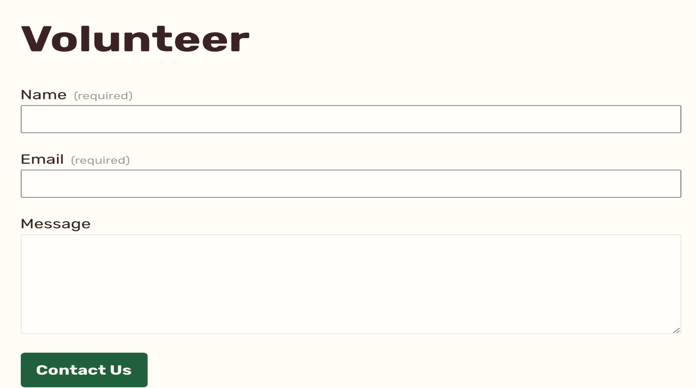
Prototypes volunteer

Slide 11
summary
By using the tools outlined in the presentation, the website for the Cardinal Cupboard will be easier to develop
The navigation and layout will provide an easy system for employees and customers to use
The goal is to have a user-friendly system that allows Cardinal Cupboard to collect and retain data and encourage new donors

